Slide 1
ACCIDENT AVOIDANCE SYSTEM USING DROWSINESS DETECTION BASED ON ML & IP
Sinhgad Academy of Engineering, Pune
Department of Electronics and telecommunication
Roll no. | Name
ETBA029 | Sahil Ramteke
ETBA010 | Shashikant Gujar
ETBA005 | Sagar Deshbhratar

Slide 2
INTRODUCTION
In today’s modern world, transportation and the need for the use of the cars, bikes and motor cycles has tremendously increased over past few decades.
The ever increase in the population is one of the reason behind the growing number of vehicles.
In today’s world the use of transportation requires lot of safety system and maintenance. Currently we are using vehicles with safety system that includes use of the brakes, air bags, seat belt etc.
But these are only helpful post-accident and lack to alert the driver before the accident occurs.
Driver fatigue detection system can be used for preventing the above problems without endangering human life and hence is one of the effective ways to stop accidents.
In driver fatigue or Drowsiness detection system it depends on the motion of eye Blinking period, the time interval between them and also the movement pattern of the head.
The system does not break down and it can be used for more advanced driver visual attention monitoring.

Slide 3
Our current statistics reveal that just in 2015 in India alone, 148,707 people died due to car related accidents. Of these, at least 21 percent were caused due to fatigue causing drivers to make mistakes.
This can be a relatively smaller number still, as among the multiple causes that can lead to an accident, the involvement of fatigue as a cause is generally grossly underestimated.
Fatigue combined with bad infrastructure in developing countries like India is a recipe for disaster. Fatigue, in general, is very difficult to measure or observe unlike alcohol and drugs, which have clear key indicators and tests that are available easily.
Probably, the best solutions to this problem are awareness about fatigue-related accidents and promoting drivers to admit fatigue when needed.

Slide 4
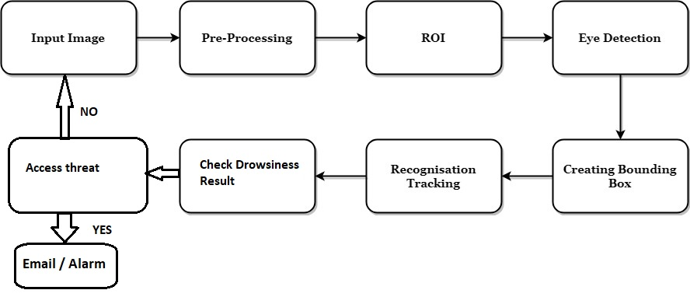
BLOCK DIAGRAM:

Slide 5
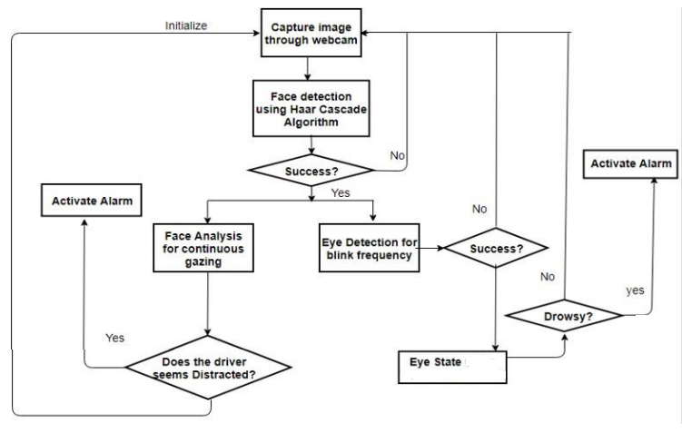
Architecture:

Slide 6
STEPS FOR PERFORMING DRIVER DROWSINESS DETECTION:
Step 1 – Take Image as Input from a Camera
Step 2 – Detect Face in the Image and Create a Region of Interest (ROI)
Step 3 – Detect the eyes from ROI and feed it to the classifier
Step 4 – Classifier will categorize whether Eyes are open or closed
Step 5 – Calculate Score to check whether Person is Drowsy

Slide 7
PROJECT PREREQUISITES / REQUIREMENTS:
The requirement for this Python project is a webcam through which we will capture images. You need to have Python (3.6 version recommended) installed on your system, then using pip, you can install the necessary packages.
OpenCV – pip install opencv-python (face and eye detection).
TensorFlow – pip install tensorflow (keras uses TensorFlow as backend).
Keras – pip install keras (to build our classification model).
Pygame – pip install pygame (to play alarm sound).
SMS Python Quickstart -- With just a few lines of code, your Python application can send Alert SMS messages with Programmable Messaging.

Slide 8
ALGORITHM OF DROWSINESS DETECTION
New Image
Adjust brightness & contrast
Face detection
YES
Success
NO
YES
Eye detection
Success
NO
YES
Extract eye region

Slide 9
Eye feature extraction
Determine – close OR open eye
Calculation of Drowsiness
Drowsy Driver
NO
YES
Alarm/Alert

Slide 10
METHEDOLOGY:
The new image is been input and is detected for the face detection.
The image brightness and contrast ratios are adjusted for the detection of face
the later it undergoes the face detection if it is detected
then it undergoes eye detection then the frame is adjusted around the eye region the eye region is extracted.
The patterns are then processing for the eye blinking, whether the eyes are open or closed during the driving of the car .
Then the data has been for the calculation of the drowsiness that the driver possess with the help of the fuzzy logic.
If the driver is drowsy then the alarm signal is set on to make the driver alert that he is undergoing drowsiness state and the driver needs to stop driving or needs precautionary measure before the driving of the car.
The first part is the eye detection function and the other is the Drowsiness Calculation function.

Slide 11
SYSTEM IMPLEMENTATION
Hardware:
The hardware used is PC.
The external hardware used is Logitech webcam which helps to capture images.
Mother Board specification is Intel pentium4 processor Memory: DDR226, USB Host and Device Port TFT LCD
Software:
Python (3.8 version recommended)
In this Python project, we will be using OpenCV for gathering the images from the webcam
OpenCV
TensorFlow
Keras
Pygame
Dataset - Drowsy Driver Detection

Slide 12
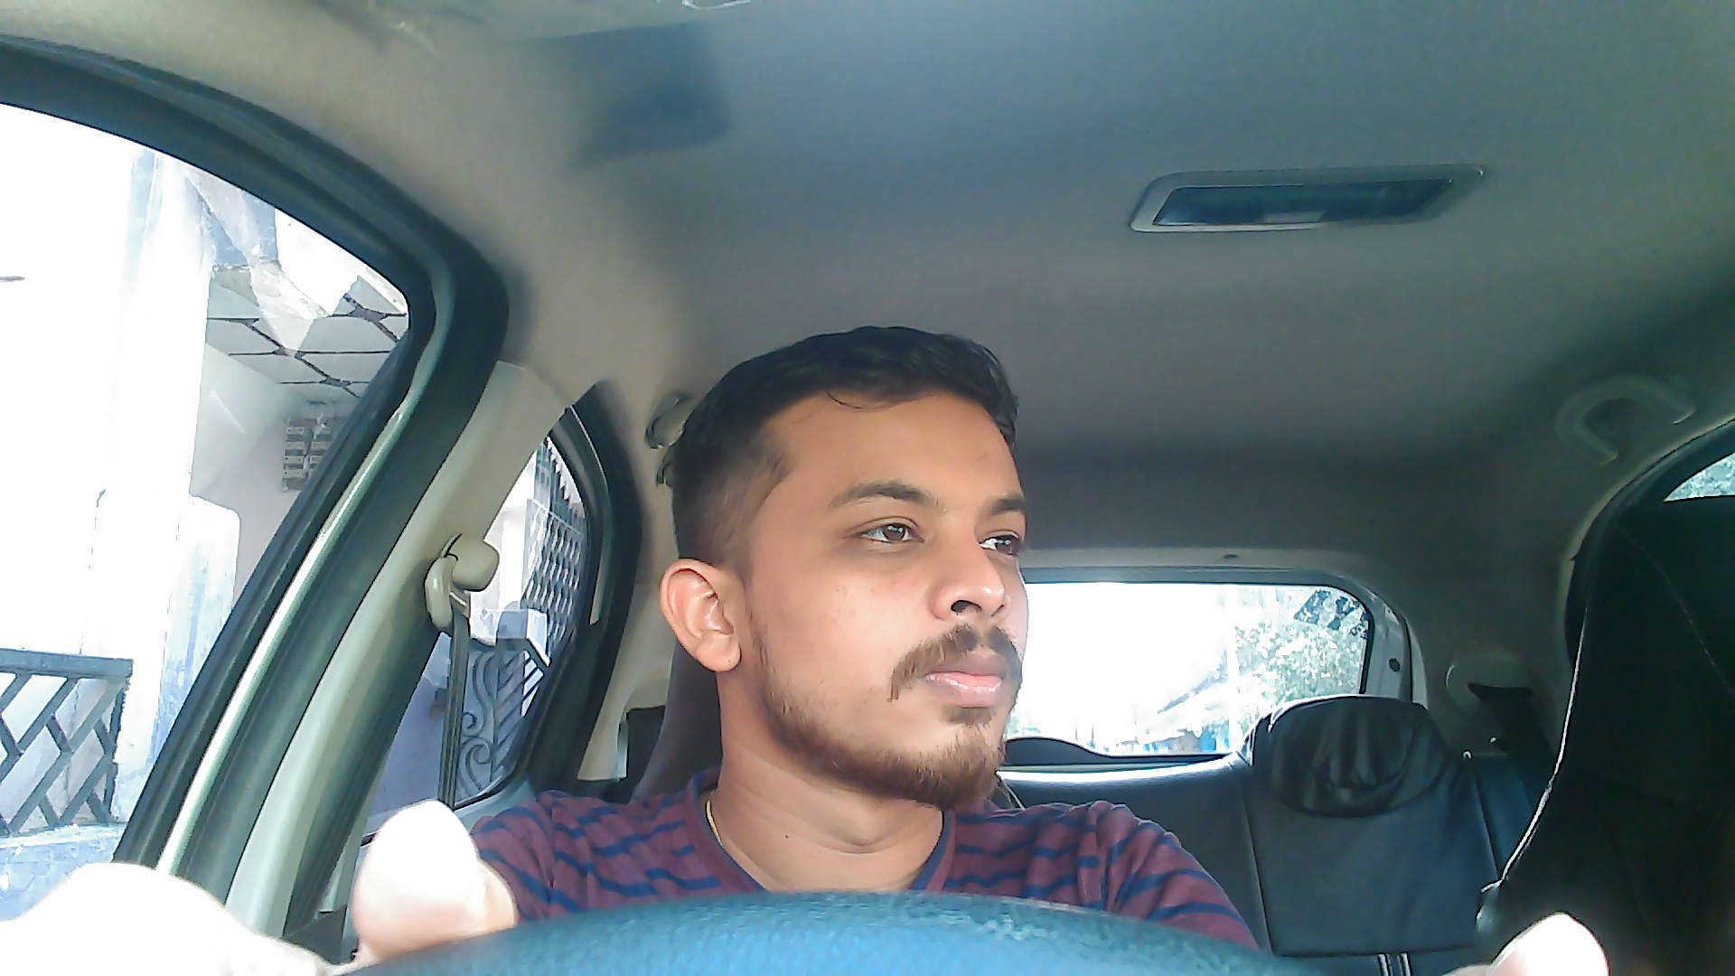
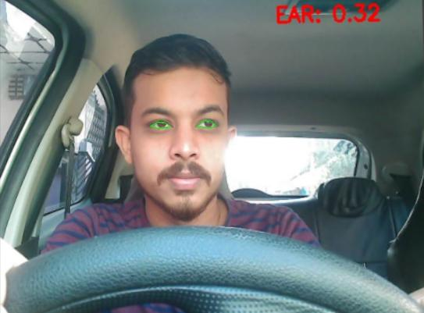
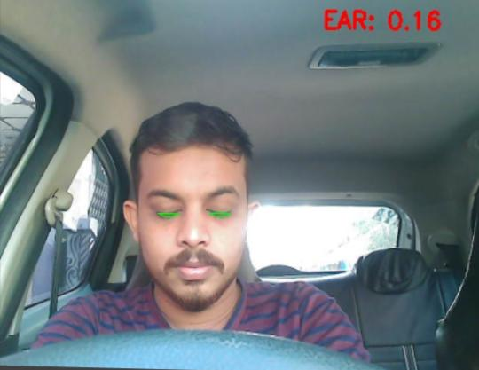
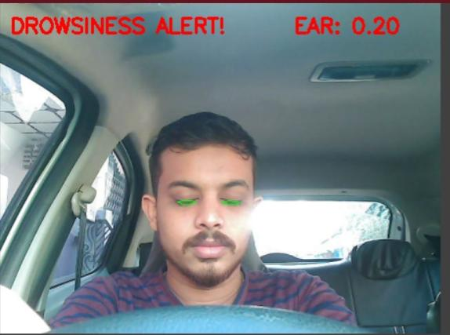
Step #1 — Look for faces in the input video stream
Step #2 — Apply facial landmark localization to extract the eye regions from the face.
Step #3 — Compute the eye aspect ratio to determine if the eyes are closed.
Step #4 — Sound an alarm if the eyes have been closed for a sufficiently long enough time.

Slide 13
ADVANTAGES: Region of interest is clear to identify Bounding box creation and tracking APPLICATIONS: Real time tracking applications Classification of small particles HARDWARE REQUIRMENTS: Camera Personal computer SOFTWARE REQUIREMENTS: Python 3.7 or above versions Anaconda software

Slide 14
REQUIREMENT ANALYSIS
Python: Python is the basis of the program that we wrote. It utilizes many of the python libraries.
Libraries:
• Numpy: Pre-requisite for Dlib
• Scipy: Used for calculating Euclidean distance between the eyelids. • Playsound: Used for sounding the alarm
• Dlib: This program is used to find the frontal human face and estimate its pose using 68 face landmarks.
• Imutils: Convenient functions written for Opencv.
• Opencv: Used to get the video stream from the webcam, etc.
OS: Program is tested on Windows 10 build 1903 and PopOS 19.04 4.3 Laptop: Used to run our code.
Webcam: Used to get the video feed.

Slide 15
CONCLUSION:
The driver abnormality monitoring system developed is capable of detecting drowsiness, drunken and reckless behaviors of driver in a short time.
The Drowsiness Detection System developed based on eye closure of the driver can differentiate normal eye blink and drowsiness and detect the drowsiness while driving.
The proposed system can prevent the accidents due to the sleepiness while driving.
Information about the head and eyes position is obtained through various self-developed image processing algorithms.
During the monitoring, the system is able to decide if the eyes are opened or closed.
When the eyes have been closed for too long, a warning signal is issued. Processing judges the driver’s alertness level on the basis of continuous eye closures.

Slide 16
REFFERENCES:
[1] Miaou, “Study of Vehicle Scrap page Rates,” Oak Ridge National Laboratory, Oak Ridge, TN,, S.P.,April 2012.
[2] Wreggit, S. S., Kim, C. L., and Wierwille, W. W., Fourth Semi-Annual Research Report”, Research on Vehicle-Based Driver Status Performance Monitoring”, Blacksburg, VA: Virginia Polytechnic Institute and State University, ISE Department, January 2013.
[3] Bill Fleming, “New Automotive Electronics Technologies”, International Conference on Pattern Recognition, pp. 484- 488,December 2012.
[4] Ann Williamson and Tim Chamberlain,“Review of on-road driver fatigue monitoring devices”, NSW Injury Risk Management Research Centre, University of New South Wales, , July 2013.
[5] E. Rogado, J.L. García, R. Barea, L.M. Bergasa, Member IEEE and E. López, February, 2013, “Driver Fatigue Detection System”, Proceedings of the IEEE International Conference on Robotics and Biometics, Bangkok, Thailand.
[6] Boon-Giin Lee and Wan-Young Chung, Member IEEE, “Driver Alertness Monitoring Using Fusion of Facial Features and Bio-Signals”, IEEE Sensors Journal, VOL. 12, NO. 7, July 2012.
[7] H. Singh, J. S. Bhatia, and J. Kaur, “Eye tracking based driver fatigue monitoring and warning system”, in Proc. IEEE IICPE, New Delhi, India, Jan. 2014.

Slide 17
THANK YOU !

